Slide 1
Lecture #0
DATA VISUALIZATION
(INT233)

Slide 2
Course details
L T P :
DATA VISUALIZATION
(INT233)
2 | 0 | 2

Slide 3

Text Book
TABLEAU DESKTOP POCKET REFERENCE: ESSENTIAL FEATURES, SYNTAX AND DATA VISUALIZATIONS by RYAN SLEEPER, SHROFF PUBLISHERS & DISTRIBUTORS PVT. LTD

Slide 4


References books
1. PRACTICAL TABLEAU: 100 TIPS, TUTORIALS, AND STRATEGIES FROM A TABLEAU ZEN MASTER (COLOR EDITION) by RYAN SLEEPER, SHROFF PUBLISHERS & DISTRIBUTORS PVT. LTD
2. HANDS-ON DATA VISUALIZATION: INTERACTIVE STORYTELLING FROM SPREADSHEETS TO CODE by JACK DOUGHERTY, SHROFF PUBLISHERS & DISTRIBUTORS PVT. LTD

Slide 5
Course Assessment Model
INT233 Marks break up*
Attendance 5
CA (Two best out of Three ATs) 45
ETE (Practical /Laptop) 50
Total 100

Slide 6
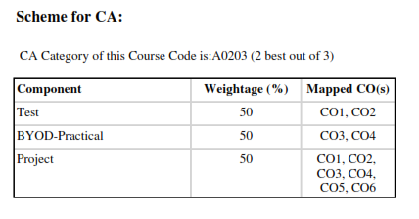

Slide 7
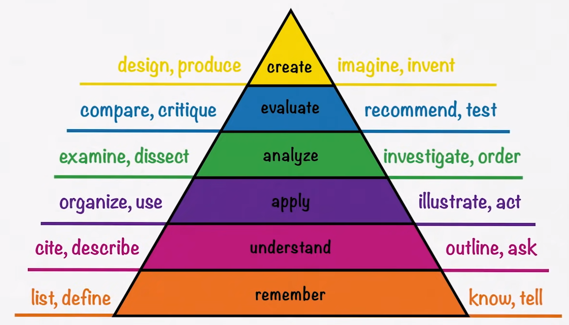
Revised Bloom’s Taxonomy
Notes:
https://www.celt.iastate.edu/instructional-strategies/effective-teaching-practices/revised-blooms-taxonomy/

Slide 8
Course Outcomes
CO1: Illustrate the role of data visualization for analytics in an organization
CO2: Use data visualization principles to help you to design dashboards that enlighten and support business decisions
CO3: Explore knowledge of data representation and sub-setting techniques for real time datasets
CO4: Use and customize the various graphical packages for creating various types of graphs, plots and charts
CO5: Analyze real life business problems by using various visualization techniques
CO6 : Integrate data to provide mashed-up dashboards

Slide 9
Program Outcomes (POs)
PO1 Computing Knowledge: An ability to apply knowledge of computing appropriate to practical work.
PO2 Problem analysis: An ability to analyze a problem, and identify and define the Project requirements appropriate to its solution.
PO3 Investigation: To know and able to experiment, analyze and interpret the data.
PO4 Design: An ability to apply design and development principles in the construction of software and database systems.
PO5 Use of computing tools: An ability to use current techniques, skills, and tools necessary for modern Information Computing Technology and communication support services.

Slide 10
Program Outcomes (POs)
PO6 Individual and teamwork: An ability to work for the infrastructural development, to pursue teaching, research & development activities and to work effectively in a group
PO7 Communication skills: An ability to communicate effectively in both oral and written individually and in team.
PO8 Professionalism: Ability to Manage time well, demonstrate an appropriate level of preparedness and maintain a high standard for personal and professional demeanor, accepting responsibility and accountability for words and actions
PO9 Impact of computing on society and the environment: An ability to analyze the local and global impact of computing on individuals, organizations, and society.

Slide 11
Program Outcomes (POs)
PO10 Ethics and equity: An ability to understand the professional, ethical, legal, and security issues and responsibilities, and the societal impact of computing.
PO11 Economics and project management: Demonstrate knowledge and understanding of the software project management principles to manage projects in multidisciplinary environments.
PO12 Life-long learning: Recognize the need for, and have the preparation and ability to engage in independent and life-long learning in the broadest context of technological change.

Slide 12
Program Specific Outcomes (PSOs)
PSO1 Apply advanced level of programming skills to provide mobile and web-based solutions.
PSO2 Design and develop solutions using computer science concepts and computational tools for information security and digital transformation.
PSO3 Acquire Competency in developing various decision-making tools with the help AI and machine learning
PSO4 Expertise in maintaining and enhancing processes and solutions.

Slide 13
Vision of School
To become one of the leading Schools globally in Electronics and Electrical Engineering recognized for its academics and innovations by nurturing professionals, researchers and entrepreneurs for sustainable growth of industry and society.

Slide 14
Mission of School
To provide a learning-based environment on technical concepts applied to real-life situations with measurable outcomes.
To establish connections with the industry for curriculum design, and creating internship cum career opportunities.
To address societal issues related to regional, national and global challenges through meaningful research
To inspire graduates for pursuing lifelong learning in professional careers.
To develop leadership potential in ethically competent entrepreneurs.

Slide 15



Slide 16
Data Visualization
Process by which numerical data are converted into meaningful 3-D images
Intended to analyze complex data
Notes:
Data from: satellite photos, sonar measurements, surveys, or computer simulations

Slide 17
Applications of Data Visualization Techniques
Retail Banking
Government
Insurance
Health Care and Medicine
Telecommunications
Transportation
Capital Markets
Asset Management

Slide 18
Syllabus

Slide 19
Unit 1- DATA VISUALIZATION FUNDAMENTALS
Basics of Data visualization
Data types
Exploratory versus explanatory visualizations
Design principles for charts and graphs
Value of Visualization
Data and Image Models
Common tools for creating data visualizations
Excel vs SPSS vs R vs Tableau

Slide 20
Unit 2- INTRODUCTION TO TABLEAU
Introduction to tool
Installing Tableau
Tableau features
Connecting data with tableau
Joining data sources
Live data connections vs data extracts
Basic functions of tableau
Operations of tableau
Usage of Menus and Toolbar
Usage of Data Pane, Analytics Pane, Sheet Tabs, Shelves and Cards, Marks Card, Legends
Layout for dashboard and stories
Difference between Green and Blue pills

Slide 21
Unit 3- MANAGING, ORGANIZING AND ENHANCING DATA IN TABLEAU
Splitting data
Pivoting & Transforming data
Blue & green pills Filters
Blue & green pills affect on dates
Cleaning data by Bulk Re-aliasing
Setting data defaults to save time later on
Create hierarchies to drill down into data
Creating groups for data
Creating and Using Sets
Create data filters
Create calculated fields
Combine data sources using data blending
Creating & using Parameters
Bringing in More data with Joins

Slide 22
Unit 4- CHART TYPES AND THEIR USAGE IN TABLEAU
Defining data and their different visualization ways
Building various charts
Visualizing data using Bar Chart, Lines Charts, Scatterplots, Heat maps, Histograms, Maps, Dual Axis Charts ,Pie Charts
Visualization data with advanced analytics Polygon Maps, Bump Charts, Control charts, Funnel charts, Pareto charts, Waterfall charts
Usage and filtration of data with charts
Visualizing categorical data
Visualizing time series data
Visualizing multiple variables
Visualizing geospatial data
Mapbox integrations
Web Mapping Services
Background Images

Slide 23
Unit 5- MATHEMATICAL AND VISUAL ANALYTICS IN TABLEAU
Math and data
Aggregate calculations
Date calculations
Logic calculations
Number calculations
String calculations
Type calculations
Conceptual Topics with LOD Expressions
Nested LOD Expressions Showing change instead of raw numbers
Summary statistics in visualizations
Annotations and pre-attentive attributes
Use visual analytics to find answers in your data
Adding annotations to visualization
Add reference lines and trend lines
Visualizing forecasting data
Clustering
Drag and drop analytics
Analysis with cube and MDX

Slide 24
Unit 6- INTERACTIVE DASHBOARDS AND STORY POINTS IN TABLEAU
Creating a dashboard
Designing dashboard
Add motions
Adding interactivity with actions
Dashboard layout and formatting
Add extra detail to visualization using Marks Shelf
Add Size, Shape, Labels, Details, Tooltips in visualization
Sharing and collaborating dashboards
Story Points and how to create them
Designing effective slide presentations to showcase data story
Publish online business dashboards with Tableau
Exporting Pdfs
Sharing Dashboard Securely

Slide 25
MOOC/ Online Resources
https://www.simplilearn.com/learn-tableau-online-free-course-skillup?term=DATA%20VISUALIZATION
https://www.simplilearn.com/free-tableau-data-visualization-course-skillup
Tableau Certified Data Analyst : (Equivalence : Full Course)
https://www.tableau.com/learn/certification/certified-data-analyst

Slide 26



